Slide 1

Wait or Synchronization
Sarower Ahmmed

Slide 2
Automation Challenges
Wait issue Synchronization of automation script with application
Maintenance of script
Xpath handling –
Dynamic object
If locator value change frequently

Slide 3
Application not able to load elements due to below issues
Network issue
Application issues
Internet slow down
Browser stopping JavaScript call

Slide 4

Data loading spinning effect

Slide 5
Default wait time in selenium
0 seconds
But QTP has 10 sec

Slide 6
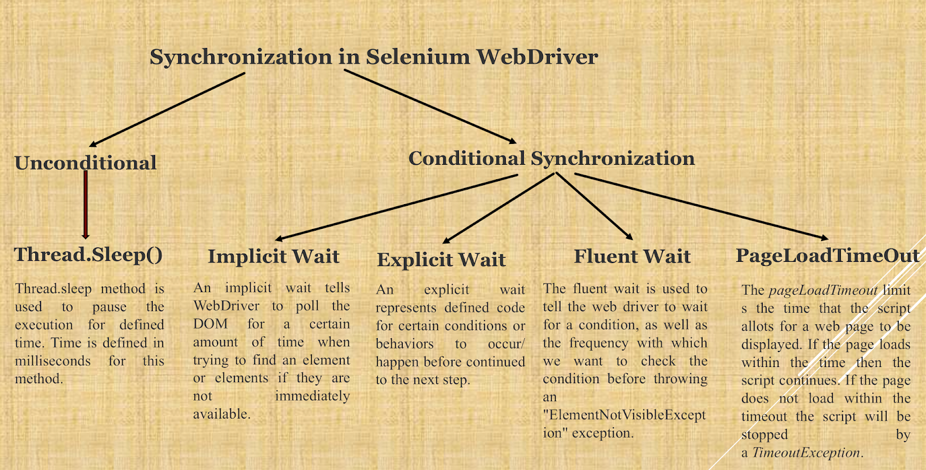

Slide 7
Synchronization or wait statements:
Many kind of wait in selenium
1)Implicite
2)Explicite
3)Fluent
Also can use for synchronization:
Thread.sleep(time) or
SetTimeout

Slide 8
Why and when?
An element not being present at all in the DOM.
Implicit wait
An element being present in the DOM but not visible.
Explicit wait
An element being present in the DOM but not enabled. (i.e. clickable)
Explicit wait
element which sometime appears in just 1 second and some time it takes minutes to appear➔ frequent check for element
Fluent wait
element need some exception handle.
Fluent wait

Slide 9
Implicit wait --
Implicit mean internal wait >> wait until whole DOM HTML page load
Work for whole script or all line of code
Disadvantage:
It will slowdown whole script or automation
Cant use to wait for specific object property
Cant handle exception
Cant check again and again (check for specific time)

Slide 10
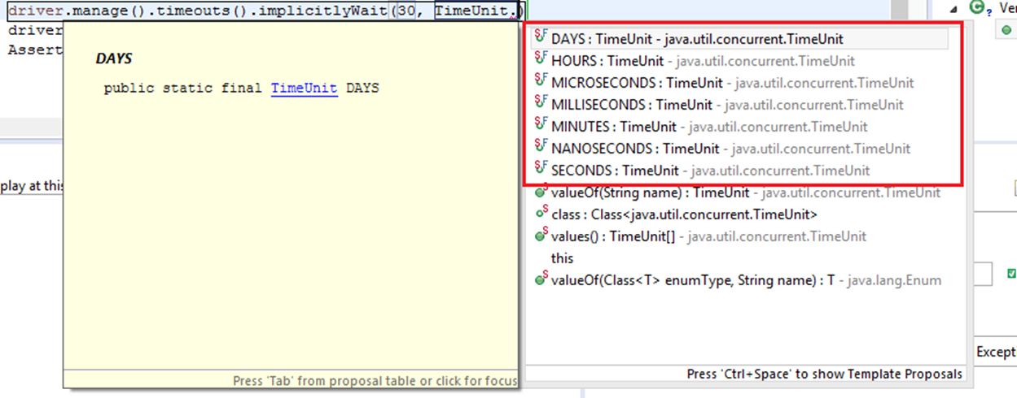
Implicit wait code
driver.manage().timeouts().implicitlyWait(10, TimeUnit.SECONDS);
TimeUnit as seconds have so many options :: Seconds, Minutes, Days, Hours, Microsecond, Milliseconds

Slide 11
Explicit wait--
Cant use to wait for specific object property like
Enable
Disable
Clickable
Visible
Numberofelement
Elementdisapeartime

Slide 12
Explicit wait
Advantage:
Never slowdown your script
Work only on one element or object
Disadvantage:
Cant handle exception
Cant use to load HTML page
Cant use again and again (specific time only)

Slide 13
Explicit code
1 2 3 | WebDriverWait wait = new WebDriverWait(driver, 10); WebElement element = wait.until (ExpectedConditions. elementToBeClickable (By.id("someid"))or web element);

Slide 14
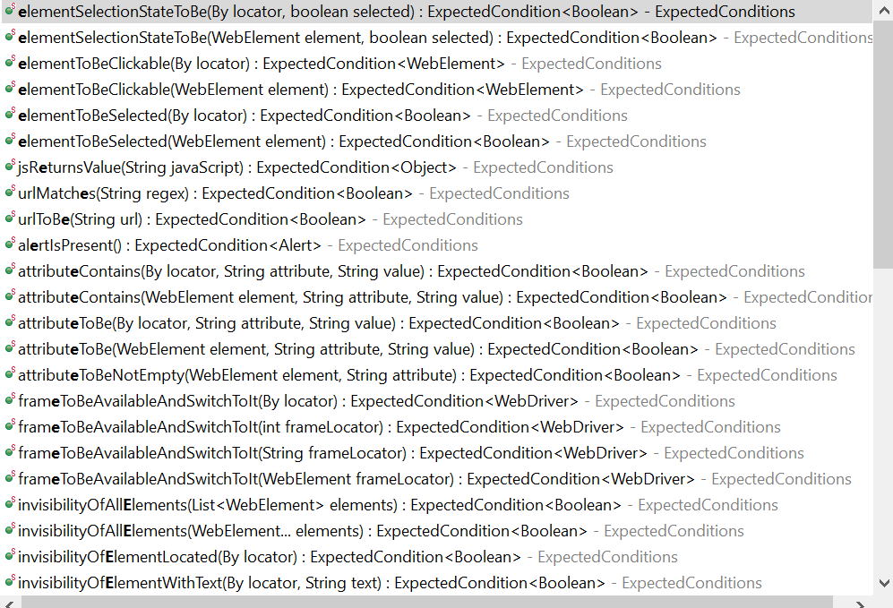
ExpectedConditions.options below

Slide 15
Implicit wait(QTP wait) | Explicit wait(wait property)
Apply for all element of script | Apply only which element are selected
No need condition | Need condition such as- Visibility of all element(), visibility of all elementlocated()
Slow down whole script | Only work on one object
Example: driver.manage().timeout.implicitewait(10,TimeUnit.SECOND) | Example: WebDriverWait wait =new WebDriverWait (WebDriverRefence.TimeOut)

Slide 16
Fluent wait
Let’s say you have an element which sometime appears in just 1 second and some time it takes minutes to appear. In that case it is better to use fluent wait, as this will try to find element again and again until it find it or until the final timer runs out.
If you need to handle exception with wait

Slide 17
Code
Wait wait = new FluentWait(driver)
.withTimeout(30, SECONDS)
.pollingEvery(5, SECONDS)
.ignoring(NoSuchElementException.class);
WebElement foo = wait.until(new Function() {
public WebElement apply(WebDriver driver) {
return driver.findElement(By.id("foo"));
}

Slide 18
Which wait is the best to use in selenium?
Explicit wait
Why?
Never slow down automation
Use only my desire element as usually wait issue usually occur one or few elements

Slide 19
Hard coding wait
Thread.sleep
TimeUnit.sleep
Advantage:
No matter what it will wait until time finished
Disadvantage:
Wait until time finished even if element is active

Slide 20
Selenium.setSpeed
we want to set a delay time 2000 for each of these, defining setSpeed() method once will accomplish the task something like below:
selenium.setSpeed("2000");
Operation 1
Operation 2
Operation 3
But if we use Thread.sleep(), it will be something like below:
Thread.sleep(2000);
Operation 1
Thread.sleep(2000);
Operation 2
Thread.sleep(2000);
Operation 3

Slide 21
Pageloadtimeout
driver.manage().timeouts().pageLoadTimeout(4, TimeUnit.SECONDS);
Like implicit wait
Wait until whole page elements loaded

Slide 22
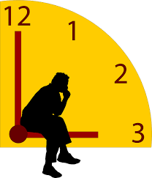

Faster is better but sometime you need to wait to prevent test failed

